Slide 1
Title Slide
Foxhole Homes:
2019 Update
Presenter: Dwight Harp
www.foxhole.org
March 20, 2019

Slide 2
Disclaimer Slide
Disclaimers:
Foxhole Homes assumes no responsibility or liability for any errors or omissions in the content of this presentation. The information contained herein is provided on an “as is” basis with no guarantees of completeness, accuracy, usefulness or timeliness.
This work is licensed under a Creative Commons Attribution-ShareAlike 4.0 International License. 2019, Foxhole Homes, Inc.

Slide 3
Mission Slide
Our Mission: Sustainable Housing and Community for Veterans In Need.

Slide 4
…for Veterans in Need.
- Over 40,000 veterans are homeless on any given night.
- 2/3rds of homeless veterans served at least 3 years.
- Homeless veterans are younger than average. 50% are under age 50.
- Homelessness among veterans commonly co-occurring with chronic illness/disability, PTSD & substance abuse.
(data from National Coalition for Homeless Veterans, <nchv.org>, Jan 2019)

Slide 5
They shall all sit under their own vines and under their own fig trees, and no one shall make them afraid. – Micah 4:4

Slide 6
Maslow’s Hierarchy

Slide 7
= Sustainable Housing & Community
6 Self-Sustainable Design Goals: food, water, energy, comfort, wastewater, refuse
Why? Self-Sufficiency &
Reduced Cost of Living

Slide 8
Who We Are
A local nonprofit (501c3) founded in 2016
Modelled after veterans’ and homeless services organizations
100% donor funded: Partnered with Holloman AFB, Big Give, NMSU-A, 100WWC, Alamogordo CoC
All-volunteer organization: Volunteers from active & retired military, 704th Test Group, Rotary clubs, Aggies Without Limits, Alamogordo & beyond
Technical Support: NMSU, 704th Test Group, Aggies Without Limits, Alamogordo HS Robotics Team

Slide 9
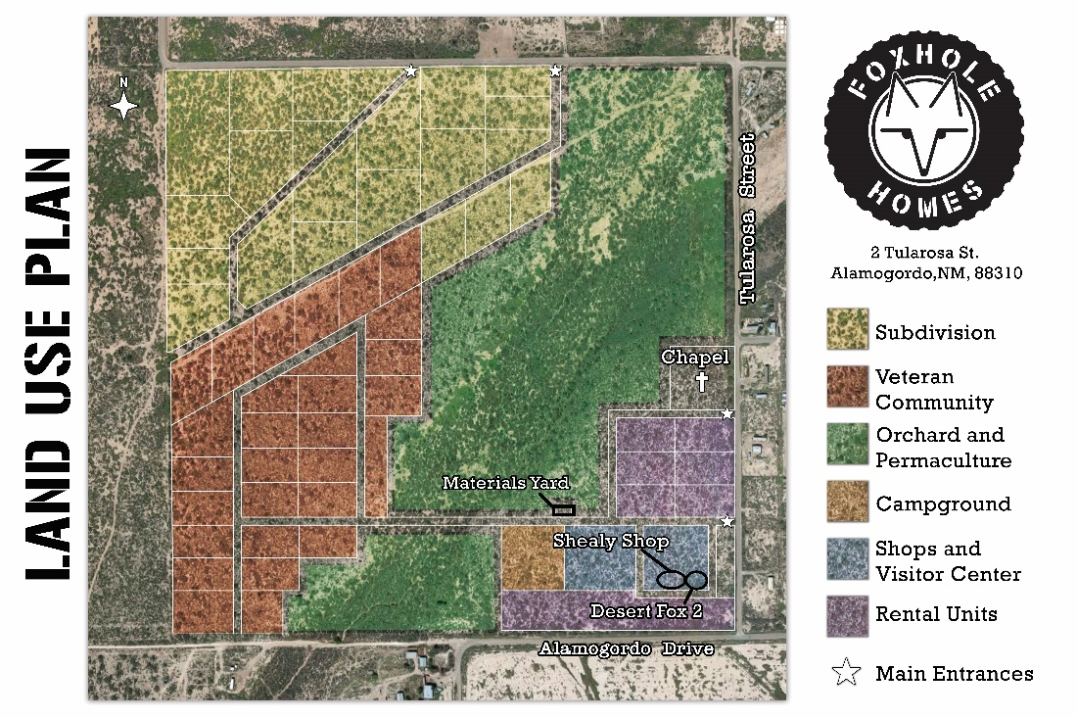
2018 Successes
Land purchase (100% donor funded!)
Materials Yard built
First permitted tire bale dwelling design in NM

Slide 10
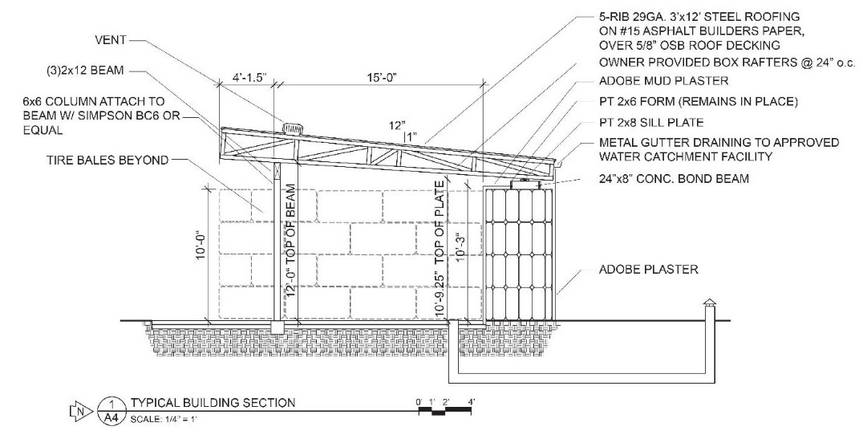
2019 Objectives
#1: A homeless veteran in a sustainable home.
Amenities and infrastructure; cooking and sanitation
Shealy Shop construction in Q2 2019

Slide 11
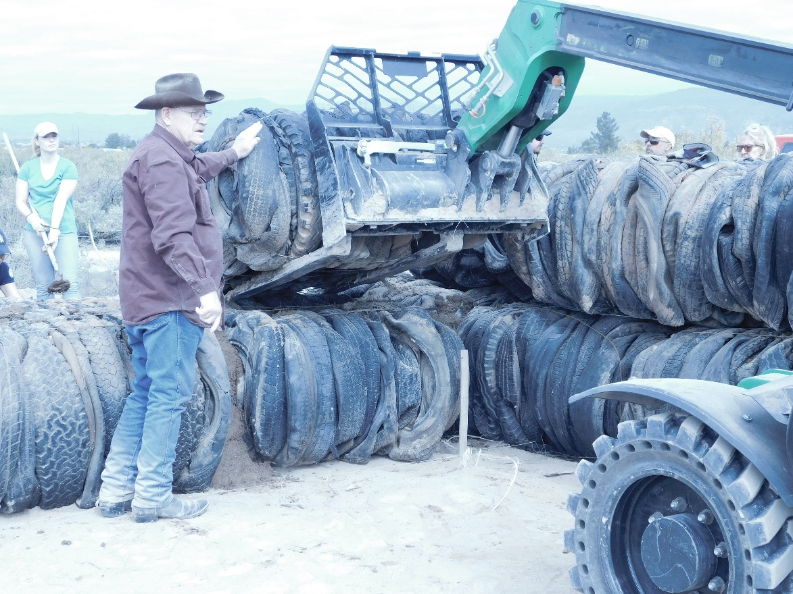
Shealy Shop for tool/equipment secure storage
Named after Michael Shealy, pioneer in tire bale construction
Consumes 5000 tires (vs 350 in DF2), 1000+ bottles
Passive HVAC

Slide 12
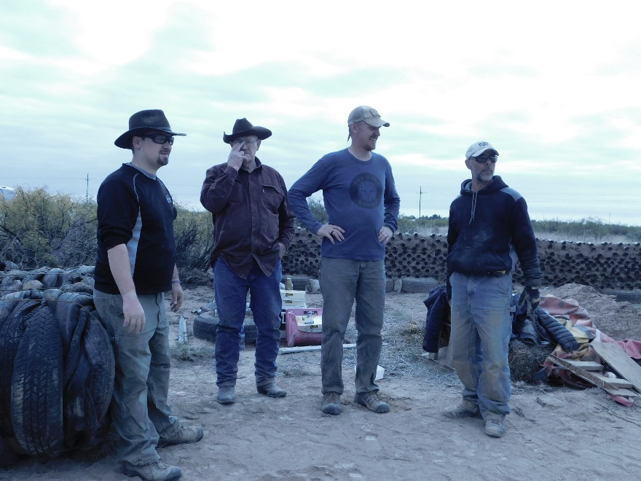
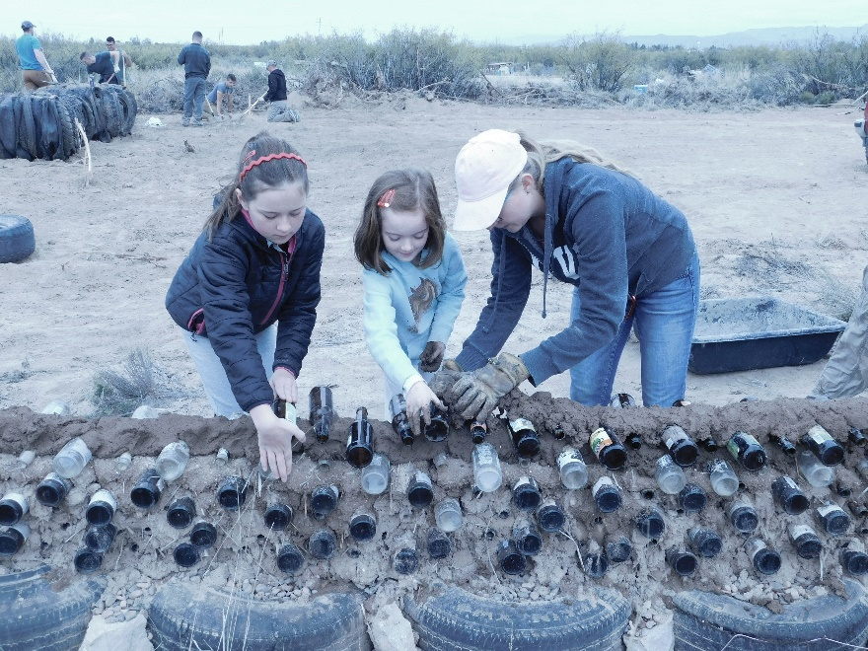
“How can I help?”
Donate! Fundraising for 1st veterans dwelling.
Tell your friends about us.
Volunteer events.
Find out more at Foxhole.org, plus FB and Youtube.

Slide 13
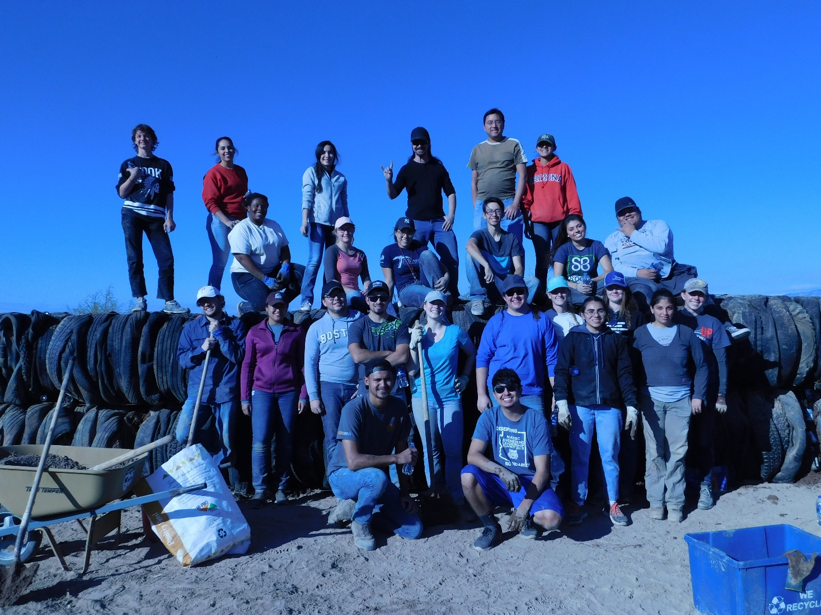
Thank You!
(Q&A Session)

Slide 14
Find us at
FOXHOLE.ORG
Or search for “Foxhole Homes” on social media

Slide 15
Influences & Ideas
Michael Reynolds (Taos, NM): Earthships and Self-Sustainable Design Goals
Brad Lancaster (Tucson, AZ): Rainwater Harvesting in Drylands
Amory Lovins (Boulder, CO): Integrated Systems and Market-Based Solutions
Alejandro Aravena: Social Housing and the Homeowner-Builder
Ted Brinegar (Alamogordo, NM)

Slide 16
Synergies
6 Self-Sustainable Design Goals: food, water, energy, comfort, wastewater, refuse
Comfort + Refuse: the “temperature battery”
Water + Wastewater + Food

Slide 17
(do not use this slide yet) Contact Information
Dwight Harp
Vice President at
Foxhole Homes
foxholehomes@gmail.com
FOXHOLE.ORG
Notes & Presentation Slides can be found at:
Foxhole.org/Media
Notes:
Title?

Slide 18
4 Eras of History

Slide 19
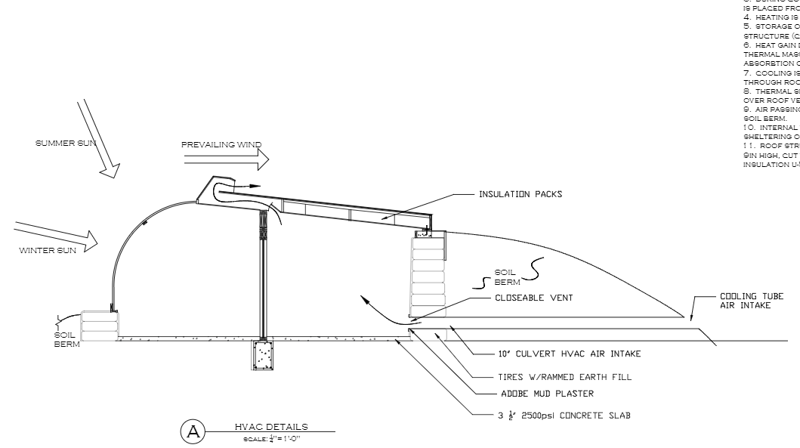
TAPE

Slide 20
The Stone the builders rejected

Slide 21
Small things matter

